Slide 1

The Ento Website project
Jayden, Joel and Callum

Slide 2
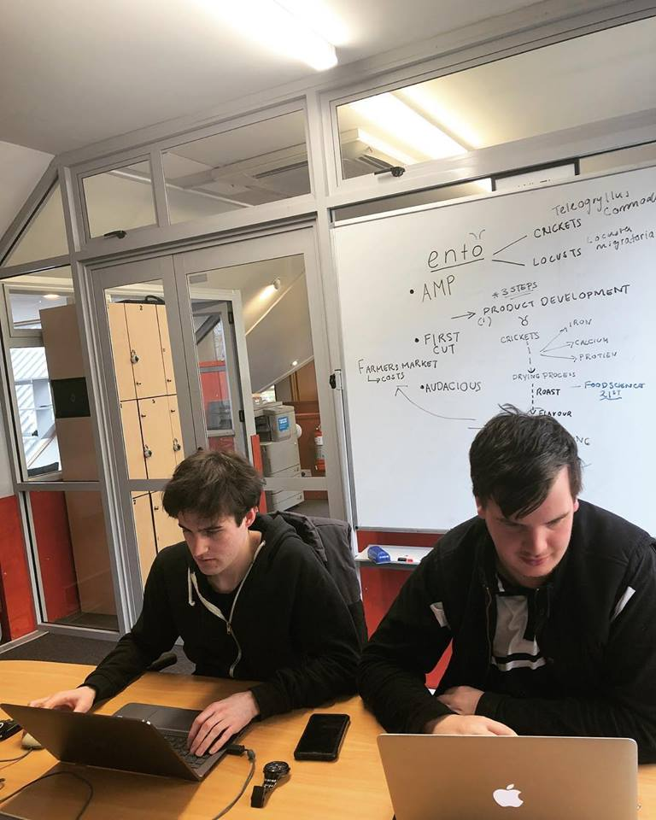
The idea
CEO George Mander (Left) and COO Liam Good (Right)

Slide 3
What we wanted
Information centre for Ento
Facts and figures
Original Content

Slide 4
What the Clients wanted
Simplistic and minimal design
Contact information/ Social Media links
To get themselves out there

Slide 5
What went right?
Got lots of good content from client
Client was really easy to work with
End result turned out well
Bootstrap was really good for laying out the site

Slide 6
What went wrong?
Had issues with the slideshow to begin with
Received minimal text content from Ento
Had issues with custom formatting for Bootstrap

Slide 7
http://webone.ict.op.ac.nz/caldja3/web-1-assignment/home.html

